Slide 1
An overview of the Open Force Field project, project aims and achievements

Slide 2

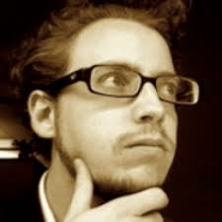
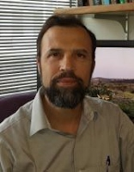

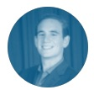
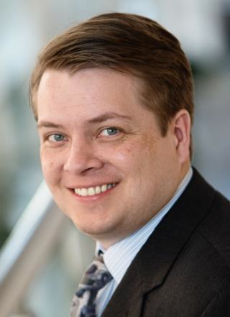

The Open Force Field Consortium
INDUSTRY
ACADEMIC
AbbVie
BASF
Bayer
Boehringer-Ingelheim
Bristol Myers Squibb
Cresset
Janssen
GlaxoSmithKline
Merck KGaA
OpenEye
Pfizer
Roche
Vertex
Eli Lilly
… and others
John Chodera (MSKCC)
Michael Gilson (UC San Diego)
David Mobley (UC Irvine)
Michael Shirts (CU Boulder)
PROJECT STAFF
Jeff Wagner
Technical Lead
Lily Wang
Science Lead
Plus affiliates:
Danny Cole (Newcastle)
Lee-Ping Wang (UCD)
Dennis Della Corte (BYU)
MolSSI (Virginia Tech)
...

Slide 3




How is the Open Force Field Initiative open?
Open source Python Toolkit: use the parameters in most simulation packages
Open curated QM / physical property datasets: build your own force fields
Open infrastructure: Run your own benchmarks; fit your own FFs
Open science: Everything done in the open/everyone can get involved
Notes:
Nothing proprietary/secret; everyone benefits. Democratization of FFs!

Slide 4
What is the Open Force Field Initiative producing?
Toolkits: Modern toolkits for rapid development, application, and evaluation of force fields
Parameters: Parameterized datasets for different model resolutions
Datasets: Curated collections of physical property measurements
Community: Bringing together top developers & users and working together to solve our problems in the open so everyone benefits
Best Practices: Measurement and calculation of physical properties
Standards: Representation of molecular systems; forcefield descriptions
Documentation: Theory; toolkit documentation; tutorials and training materials
Publications: Communicating the ideas behind our work to the scientific community

Slide 5
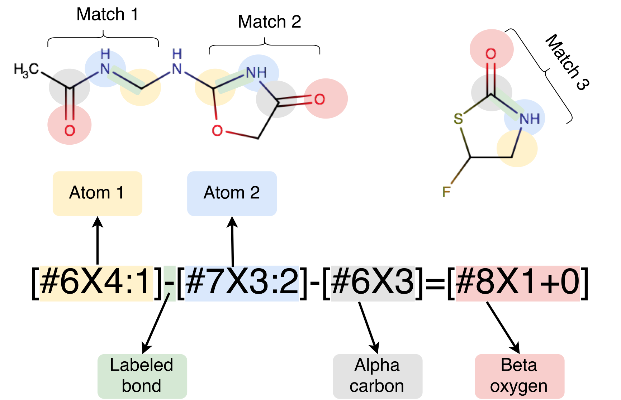
The SMIRKS Native Open Force Field spec. (SMIRNOFF) avoids atom typing, simplifies parameter assignment
match bonds directly:
Use of industry-standard SMARTS/SMIRKS chemical perception greatly simplifies tooling for parameter assignment while solving issues with extensibility and flexibility

Slide 6
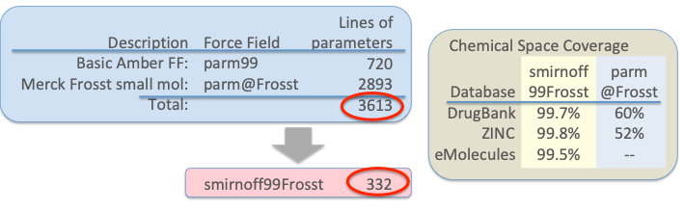
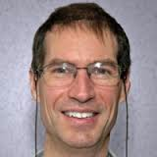
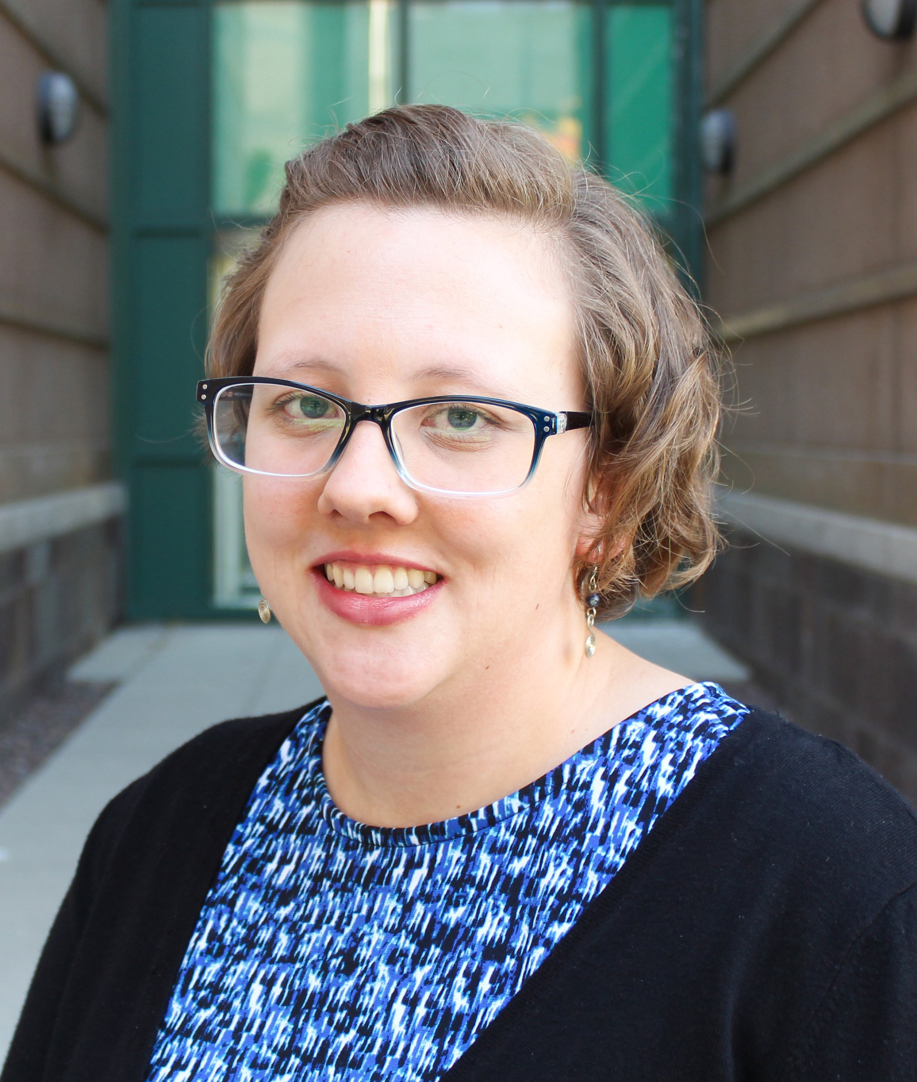
SMIRNOFF allowed significant compression of smirnoff99Frosst, our AMBER-lineage starting point
Less than 1/10 the size of the original force field
Removes redundancy
Almost completely covers pharmaceutical chemical space

Slide 7
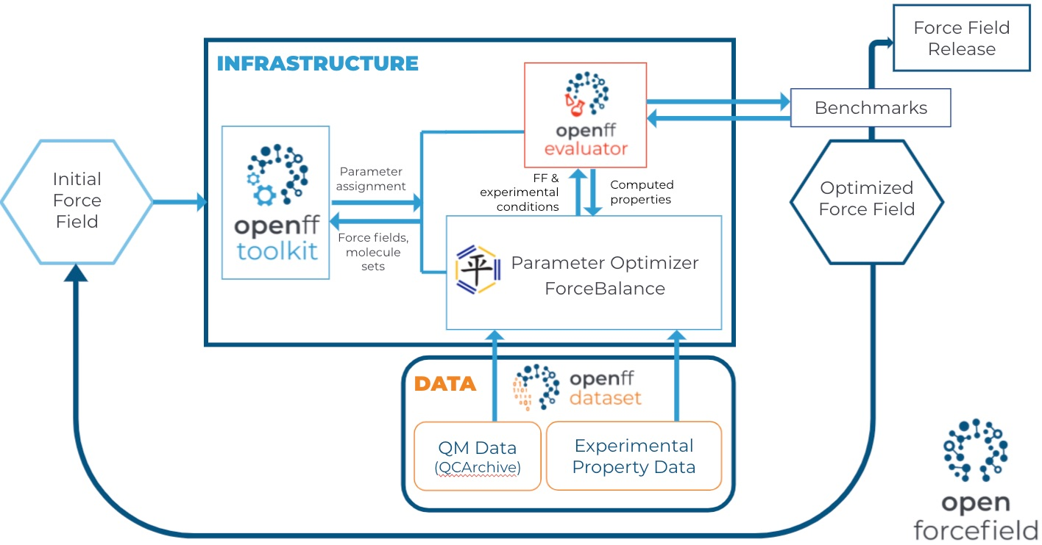
We’ve come a long way since our late 2018 start
Notes:
Started in Oct. 2018. A key part of our first year, we’ll call it 2019, was building out this infrastructure. Culminated in about three or four FF fits in a couple of months to release OpenFF 1.0
Image source here: https://docs.google.com/presentation/d/1d5hbFAmz0jgLCavhNTgjfqwWTvKELFLvrQ52B6u0XzI/edit#slide=id.p6

Slide 8
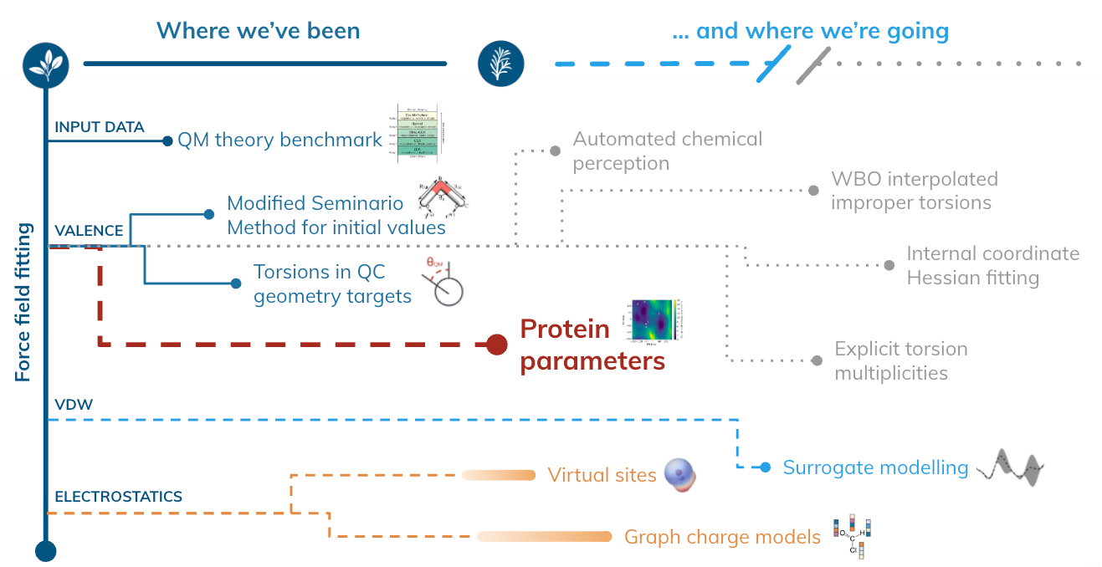
There’s a ton of great science going on

Slide 9
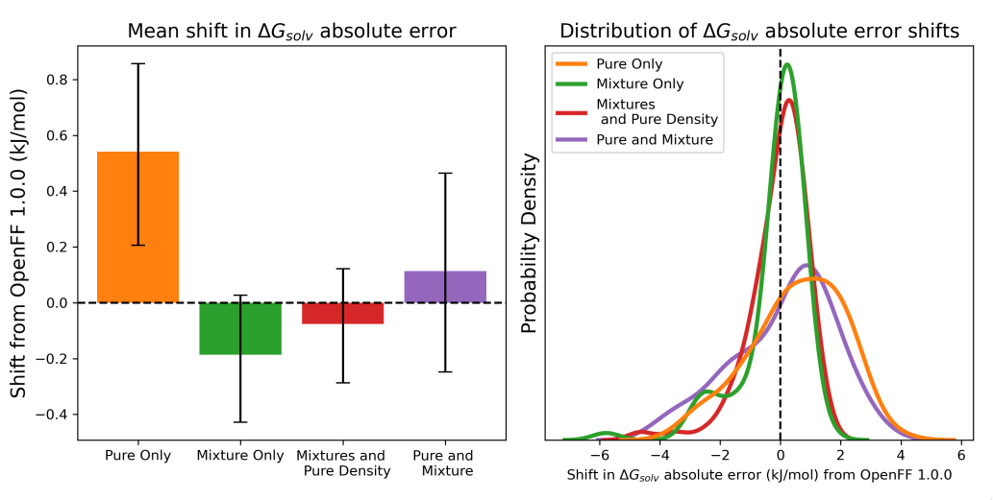
In Sage, fitting to mixture data substantially improved force field predictive power, a totally new result
Benchmarked refit vdW parameters against solvation free energies + transfer free energies
Subset of FreeSolv and MNSol
Training to mixture data significantly improves performance relative to training to pure data only, or pure + mixture

Slide 10
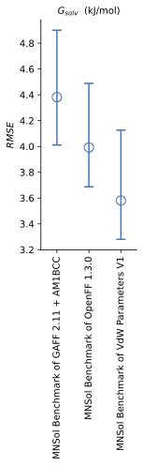
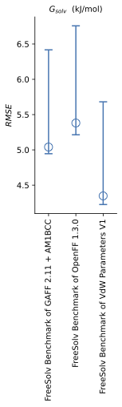
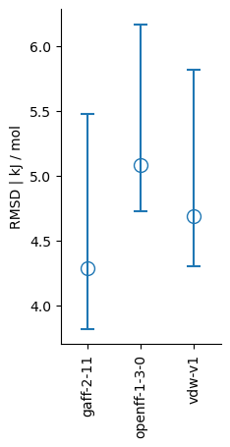
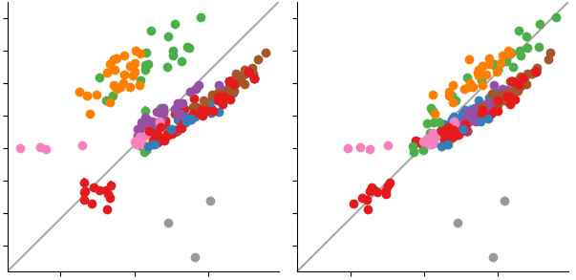

Our Sage release does better on mixture and condensed phase properties
PREVIOUS STUDY SHOWS FITTING TO H_{MIX} RESOLVES SYSTEMATIC ERRORS
Non- aq. ΔG_{solv}
aq. ΔG_{solv}
Non-aq. -> aq. ΔG_{trans}
openff-1.0.0
H_{mix}(𝑥) + 𝜌(𝑥)
Experimental H_{mix}
RMSE kJ / mol
Estimated H_{mix}
Estimated H_{mix}
alcohol + ester
alcohol + ketone
Notes:
Emphasise that it’s this approach that should IN THE FUTURE enable use to train small molecule, amino acid, sugar etc interactions self consistently. Clearly wins to be had by capturing mixture interactions especially for different concentrations

Slide 11
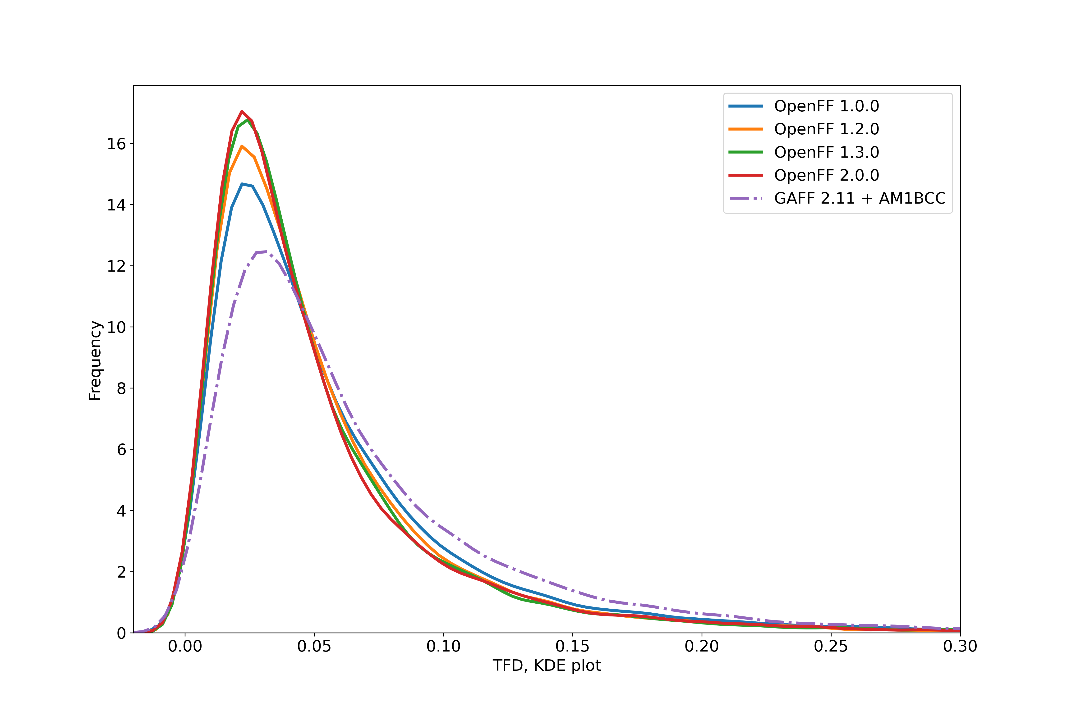
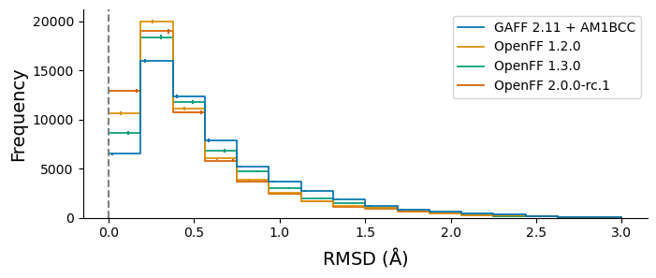
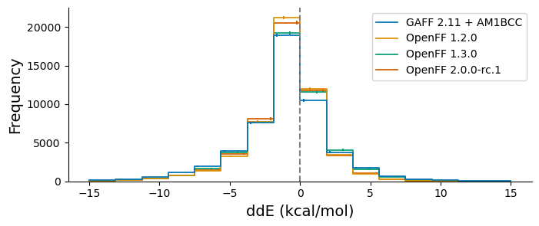
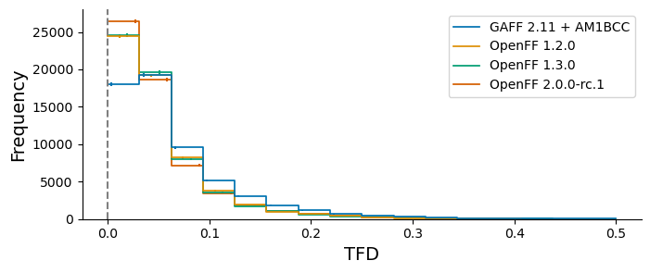
Automated benchmarking with industry has been great, indicates progress relative to QM
SAGE showed excellent performance when benchmarked against the Public OpenFF Industry Benchmark Season 1 v1.0
* 95% bootstrapped confidence intervals

Slide 12






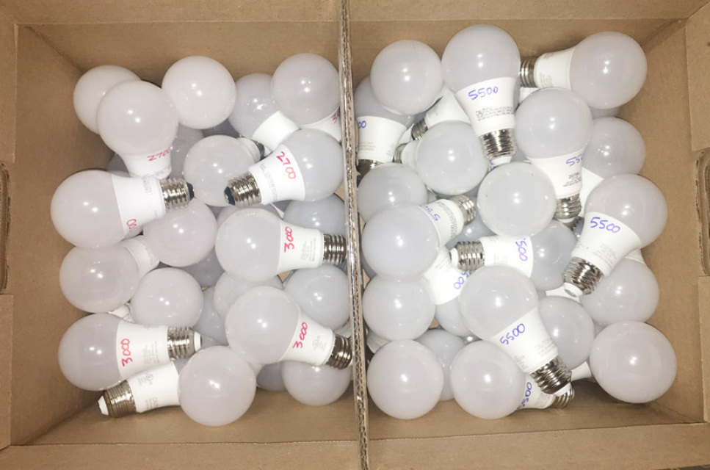
The process works, and it’s changing how we think about building force fields
We viewed this originally as a linear, planned process
FF
ForceBalance
Test
We’re learning it works better as a parallel process where the best ideas may be unexpected and apparent only later
...
Notes:
Examples of serial: WBO interpolation had been promised for Sage release, but it’s not quite ready yet, so we’re deferring
Examples of parallel: Bespoke fit, modified Seminario approaches weren’t part of mainstream plans for FF but they’re solving some of our problems so we’re pulling in key ideas, infrastructure or using them to improve FFs
Mention broader collaborations: Cole group, Roitberg group, Della Corte, Cresset, Relay …

Slide 13

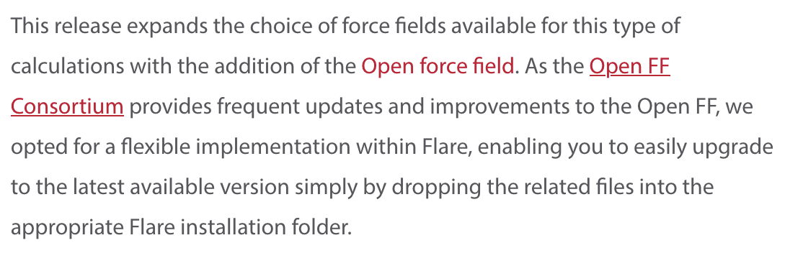
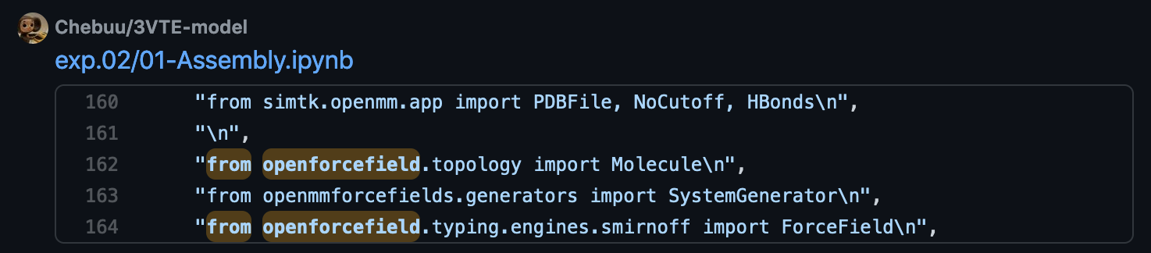
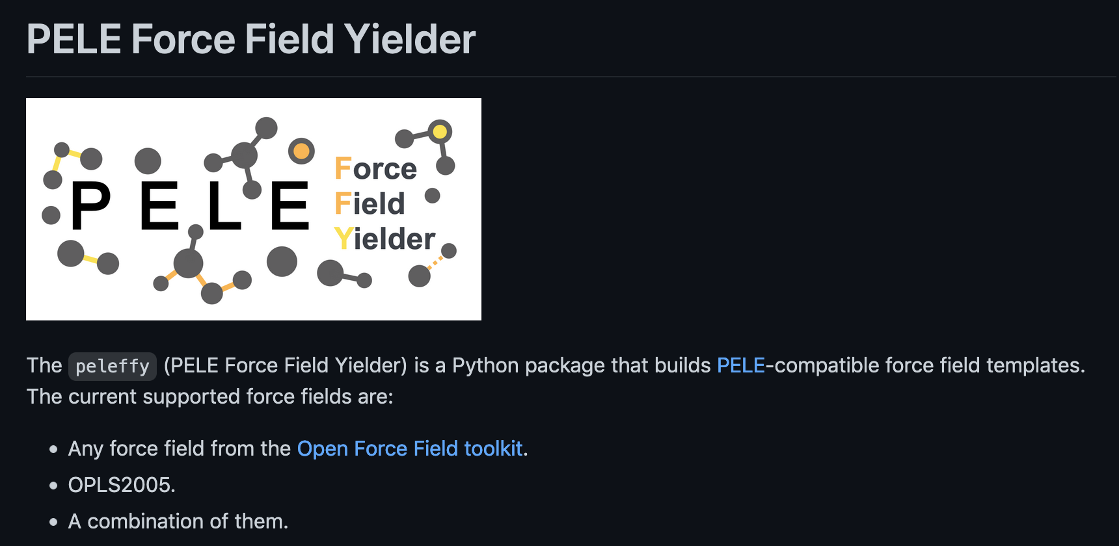
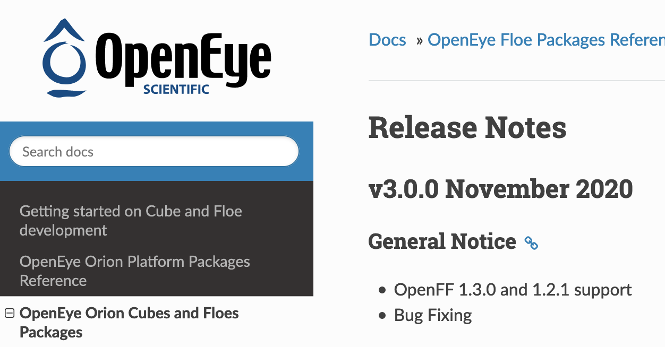

Infrastructure
Making it easy to USE force fields
Use of OpenFF tools outside the Initiative
Companies including Cresset and OpenEye
Collaborators including MoSDeF, Rowley, and Cole labs
Unaffiliated groups around the world
Strangers on GitHub!
Notes:
On the previous slide, I mentioned that we’re designing our software to become part of other workflows
This is hard thing to measure -- for the first two years, we were throwing software releases and force fields into a void
We’ve engaged in a few direct collaborations, for example with the MoSDeF efforts, and these are going well, but what we’d really like to reach is spontaneous adoption
And what’s exciting is that now we’re starting to see results sprouting
Go through bullets
So I think this reflects well on our efforts to make our results easy for people to use

Slide 14
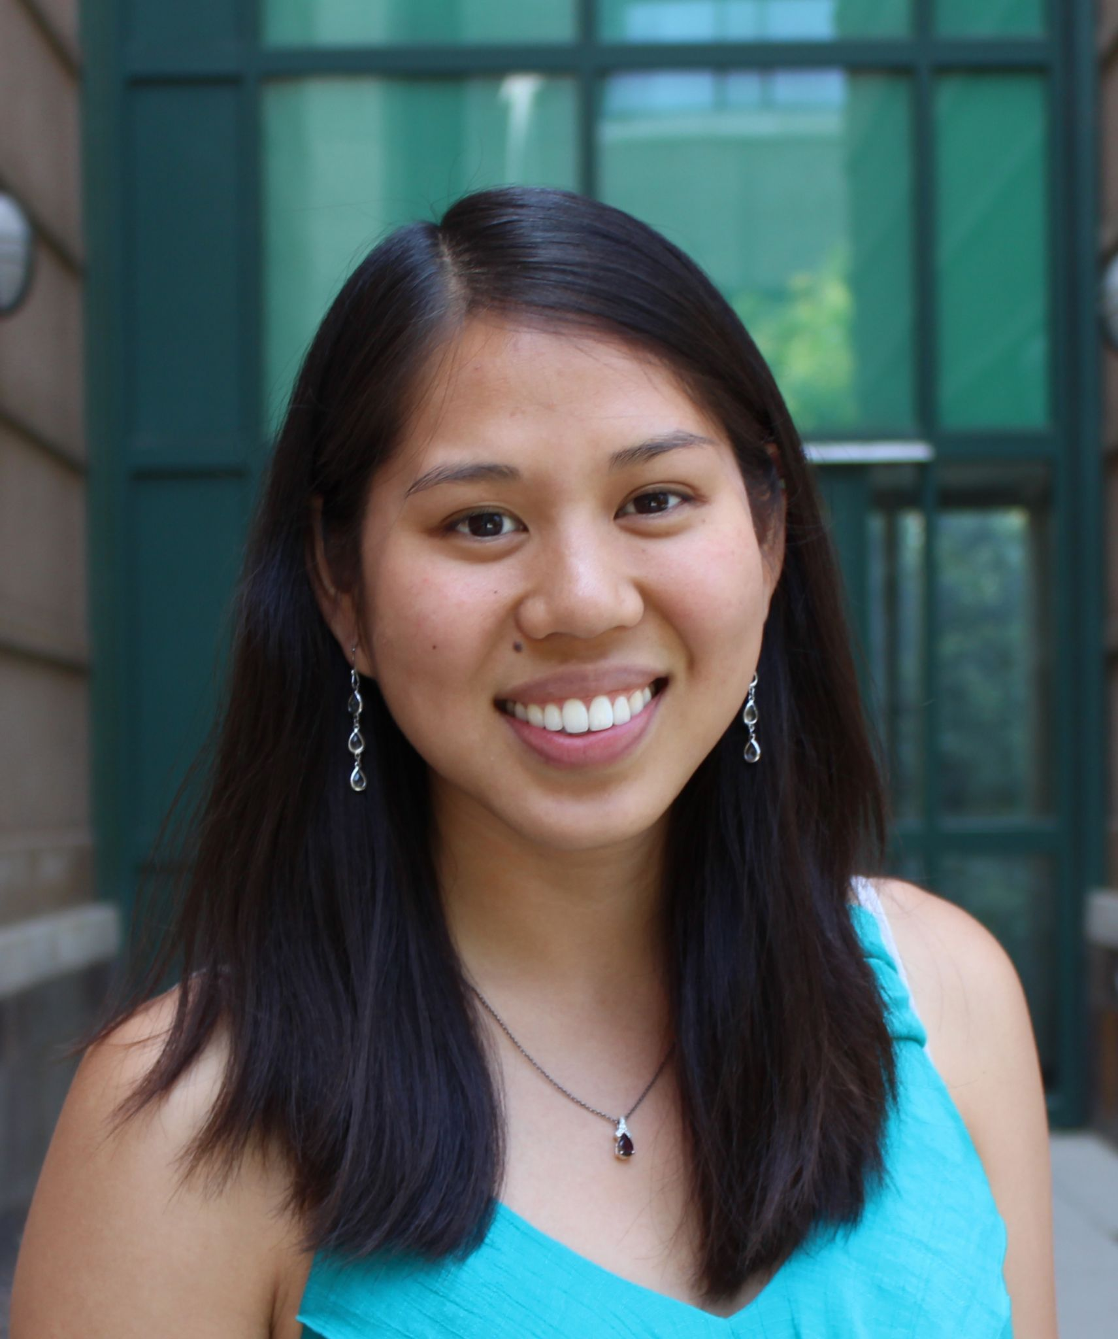
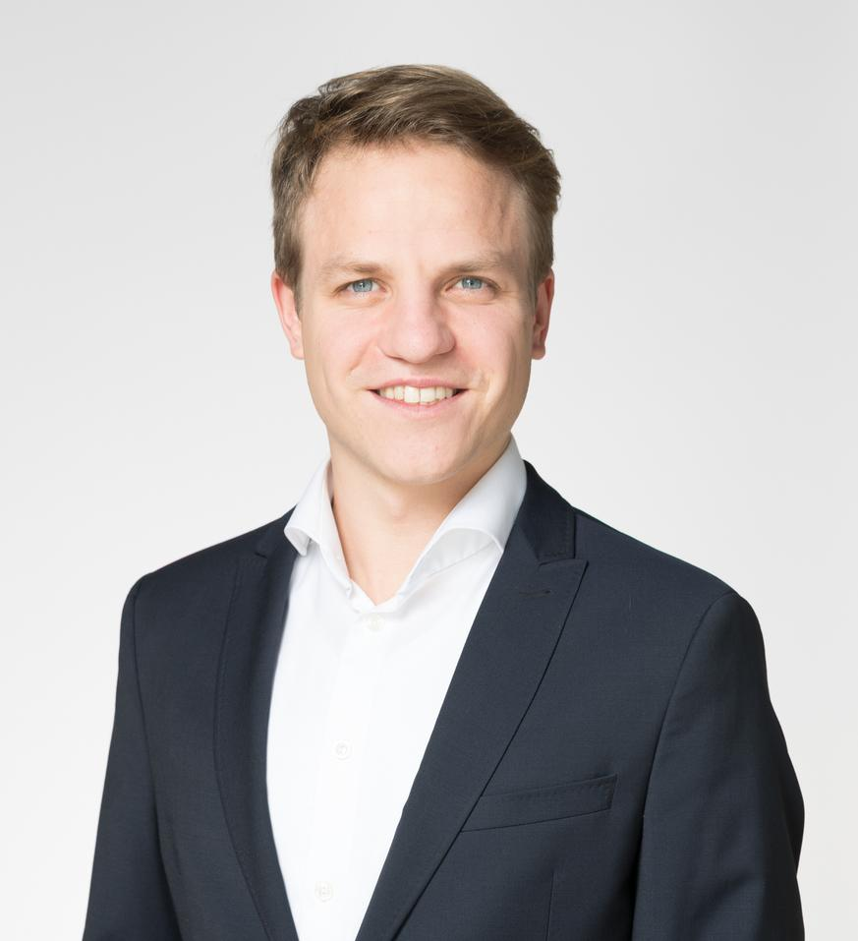

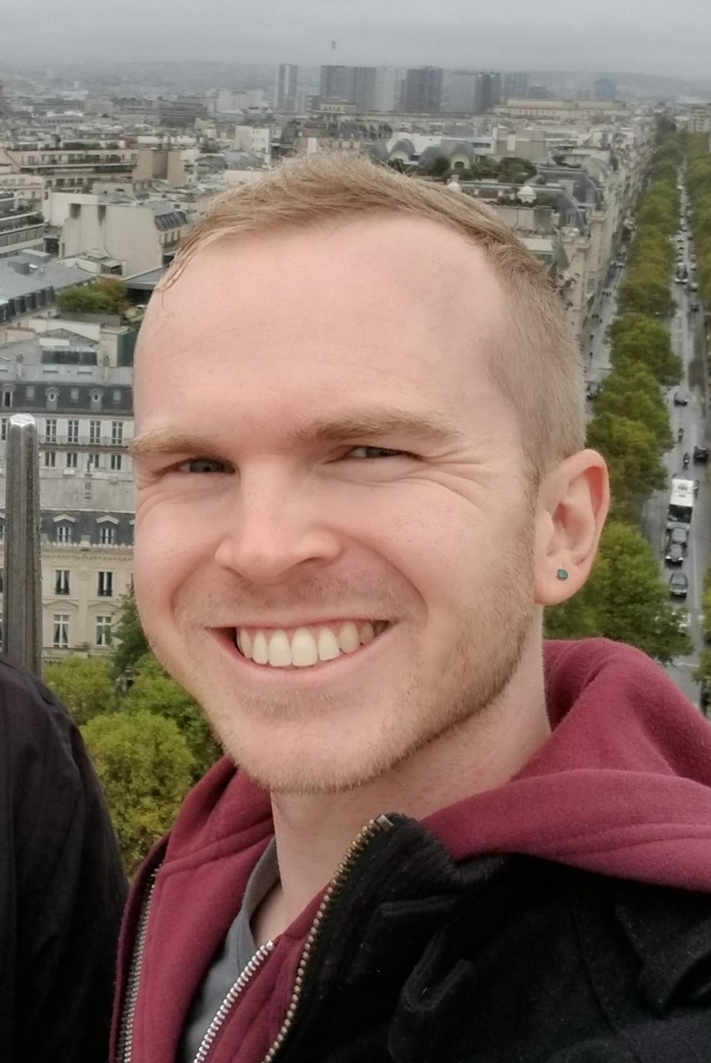
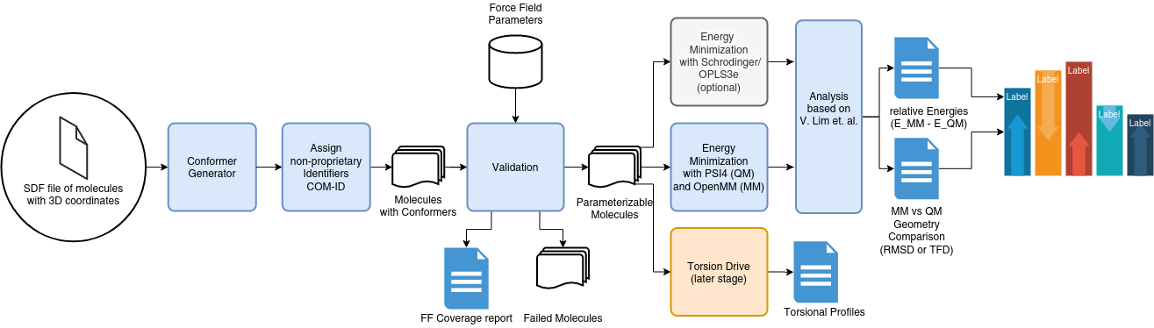
Infrastructure
Making it easy to COMPARE force fields
OpenFF Benchmark
Automates running the Lim and Hahn benchmark
CLI-first approach, using OpenFF Python backend
Heavily pinned environments and conda installers to provide consistent results
Lim VT, Hahn DF, Tresadern G et al. Benchmark assessment of molecular geometries and energies from small molecule force fields [version 1; peer review: 2 approved]. F1000Research 2020, 9(Chem Inf Sci):1390 (https://doi.org/10.12688/f1000research.27141.1)
Notes:
The Open force field team had been talking about how to get people to try our stuff
Basically, it’s a chicken and egg problem, where people have finite time, and they’d need to SPEND some of that time using our stuff in order to be CONVINCED that it works, but they won’t spend the energy to try it UNLESS they already think it’ll work
Earlier this year, we began an effort to automate the Victoria Lim and David Hahn force field comparison study.
Our goal with this was to let people test OUR force fields on a dataset of THEIR choosing, in as automated a fashion as possible.
David Dotson made this figure to explain how it works:Explain figure
Each company participating in the study submitted some non-proprietary 3D compounds to us, and we’re running the workflow on those.
They’re also running a separate dataset of their choosing internally, and we’re collecting the summary statistics of those to produce a big pooled study.
So, hopefully, this has people seeing the performance of our force fields and tools on molecules that they really care about.
What was surprising was how smoothly the distribution of this software went.
We packaged the openFF toolkit, openMM, the psi4 quantum chemistry software, QCEngine, and QCSubmit with a small CLI frontend, and people were actually able to feed in molecules and have thousands of QC jobs executed locally.
It was super cool, and I think it worked because of our great team and the way we’ve been developing open force field software internally to be intercompatible.

Slide 15



OPEN Software, OPEN Data, OPEN Science is rapidly facilitating force field science!
OPEN SOFTWARE
OPEN DATA
OPEN SCIENCE
Automated infrastructure enables rapid experimentation with minimum human intervention
Access to large, high quality experimental and quantum chemical data facilities easy curation of balanced train / test sets
Exploring new force field science:
hypothesis - build software - train - test - iterate
is now almost routine

Slide 16
OpenFF Sage - select vdW parameters trained against experimental MIXTURE enthalpies and densities
PREVIOUS STUDY SHOWS FITTING TO H_{MIX} RESOLVES SYSTEMATIC ERRORS
Mixture properties offer large benefits over pure properties alone
Easily incorporate interactions between solvent, ligands, amino acids, sugars etc
Training set includes ~1000 mixture enthalpy and density data points (NIST ThermoML)
Directly includes aqueous (TIP3P) mixtures
Small organic molecules (C, H, N, O, Cl, Br), ambient conditions, 3 concentrations
Made possible by the OpenFF Evaluator
openff-1.0.0
H_{mix}(𝑥) + 𝜌(𝑥)
Experimental H_{mix}
Estimated H_{mix}
Estimated H_{mix}
alcohol + ester
alcohol + ketone
Notes:
Sage not only first release that includes a select set of refit vdW parameters, but vdW parameters refit to mixture properties based on data driven OpenFF science.
Emphasise that it’s this approach that should IN THE FUTURE enable use to train small molecule, amino acid, sugar etc interactions self consistently. Clearly wins to be had by capturing mixture interactions especially for different concentrations

Slide 17
OpenFF Sage - positive improvements observed for solvation / transfer free energies
Benchmarked refit vdW parameters against solvation free energies + transfer free energies
Subset of FreeSolv and MNSol
Some caution required given fixed charged force field
While outlook looks positive, biggest gains likely once electrostatics consistently refit
Non- aq. ΔG_{solv}
aq. ΔG_{solv}
Non-aq. -> aq. ΔG_{trans}
RMSE kJ / mol
Notes:
Need to stress here again that although the first pass at vdW refits are likely showing a step in the right direction, this is a STEPPING STONE for bigger things. This fitting approach is critical for our future efforts for self consistent bio-polymer and small molecule interaction parameters.

Slide 18
OpenFF Sage - without introducing new QC data we’ve again improved opt-geo RMSD and ddE
SAGE 2.0.0 showed excellent performance when benchmarked against the Public OpenFF Industry Benchmark Season 1 v1.0
* 95% bootstrapped confidence intervals
Notes:
Showing that even without introducing new data, re-evaluating choice of fitting approach can still yield incremental improvements. The power of the automated benchmarking infrastructure, combined with diverse molecules of pharma interest, allows us to more rapidly perform test fits as evaluating ‘has this improved’ becomes more routine and standardised.

Slide 19
The protein-ligand benchmark set consists out of
22 targets, 599 ligands and 1150 alchemical perturbations
Content/preparation of Benchmark set might change in the future.
What is the purpose for changing (better quality, new chemistries, …)?
How do we ensure that we always compare calculations with the same input structures?
Sources
Schrodinger JACS L. Wang et al. , J. Am. Chem. Soc., 2015, 137 , 2695 —2703.
Merck KgGA Christina E. M. Schindler et al., Large-Scale Assessment of Binding Free Energy Calculations in Active Drug Discovery Projects, J. Chem. Inf. Model. 2020, 60, 11, 5457–5474
Janssen/Other: V. Gapsys et al., Large scale relative protein ligand binding affinities using non-equilibrium alchemy, Chem. Sci., 2020,11, 1140-1152 Laura Perez Benito et al., Predicting Activity Cliffs with Free-Energy Perturbation, J. Chem. Theory Comput. 2019, 15, 3, 1884–1895
Best practices: Hahn DF et al., Best practices for constructing, preparing and evaluating protein-ligand binding affinity benchmarks.arXiv:210506222 [physics,q-bio].2021 May;
Target | # Ligands | #Perturbations | Target | # Ligands | #Perturbations
jnk1 | 21 | 31 | bace_p2 | 12 | 26
pde2 | 21 | 34 | tyk2 | 16 | 24
thrombin | 11 | 16 | ros1 | 28 | 63
p38 | 34 | 56 | eg5 | 28 | 65
ptp1b | 23 | 49 | cdk8 | 33 | 54
galectin | 8 | 7 | hif2a | 42 | 92
cdk2 | 16 | 25 | pfkfb3 | 40 | 66
cmet | 24 | 74 | pde10 | 35 | 36
mcl1 | 42 | 71 | shp2 | 26 | 56
bace | 36 | 58 | syk | 44 | 101
bace_hunt | 32 | 60 | tnks2 | 27 | 60
 |  |  | total | 599 | 1150
https://github.com/openforcefield/protein-ligand-benchmark

Slide 20
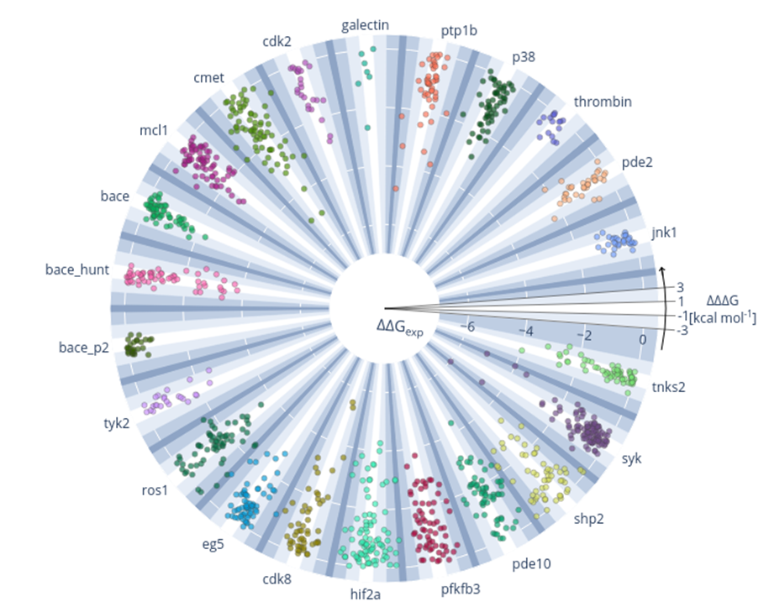
Results for all perturbations using pmx and Parsley (OpenFF 1.0.0)
Overview over all calculations performed
Radial: exp. ΔΔG in kcal/mol
Polar: difference between calc. and exp. ΔΔG, ΔΔΔG in kcal/mol

Slide 21
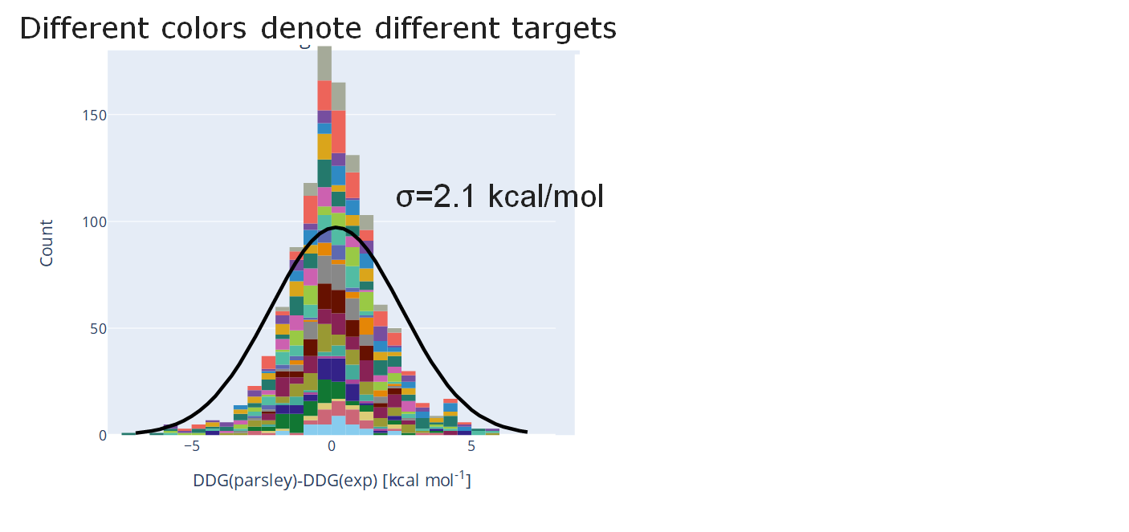
Most perturbations (∆∆G) deviate less than 1 kcal/mol from experiment
Abs. Error [kcal/mol] | # Perturbations | % of total
< 0.5 | 322 | 29
<1.0 | 592 | 52
<2.0 | 911 | 79
<3.0 | 1052 | 92
total | 1149 | 100
Origin of errors:
Set-up (poses, charges)
Sampling (simulation time)
Model accuracy (Force Field)
Experimental data

Slide 22
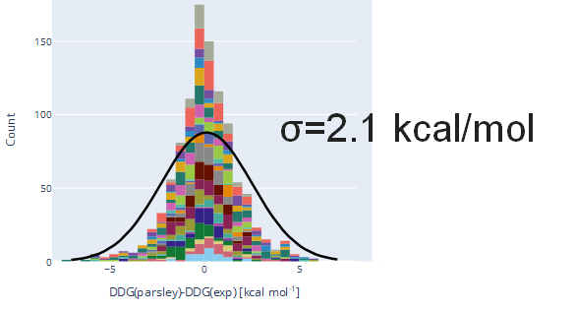
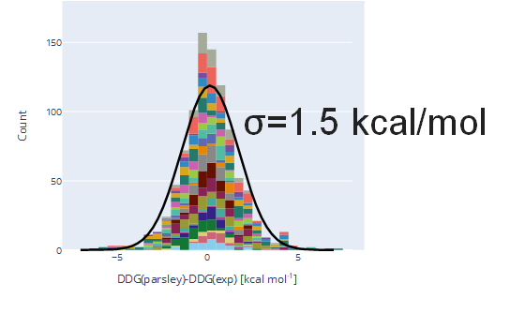
Results can be filtered based on different convergence metrics
All perturbations
Filtered perturbations
Abs. Error [kcal/mol] | # Perturbations | % of total
< 0.5 | 322 | 29
<1.0 | 592 | 52
<2.0 | 911 | 79
<3.0 | 1052 | 92
total | 1149 | 100
Abs. Error [kcal/mol] | # Perturbations | % of total
< 0.5 | 383 | 32
<1.0 | 508 | 57
<2.0 | 748 | 85
<3.0 | 835 | 94
total | 885 | 100

Slide 23
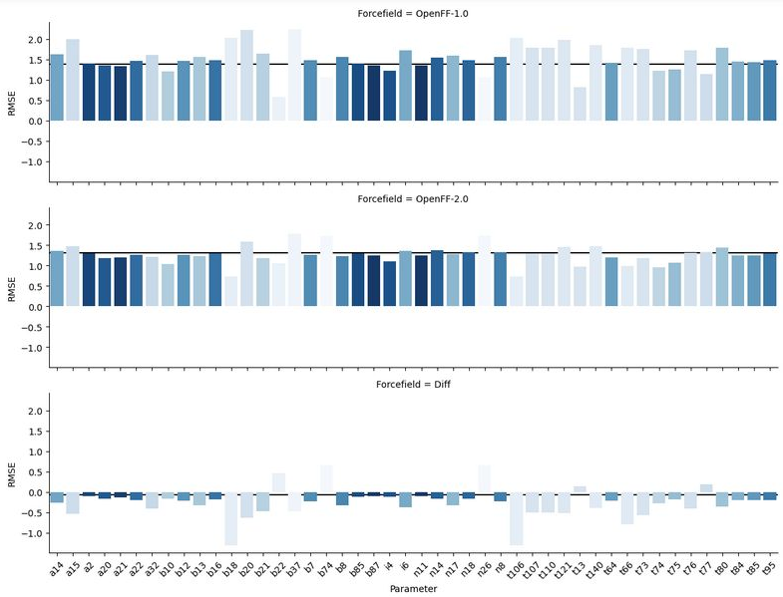
OpenFF-2.0 improved results over OpenFF-1.0

Slide 24
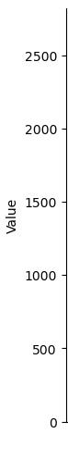
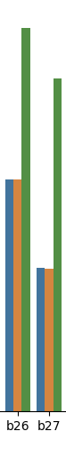
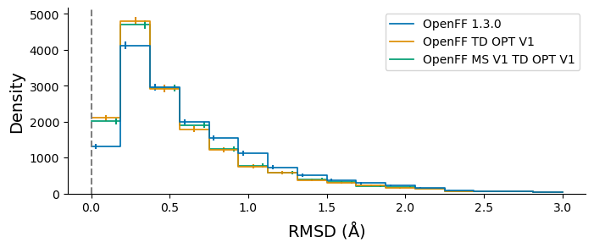
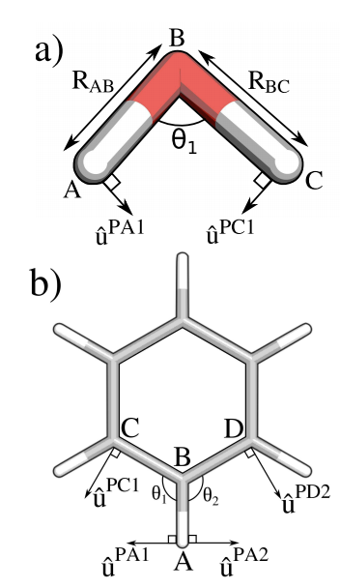

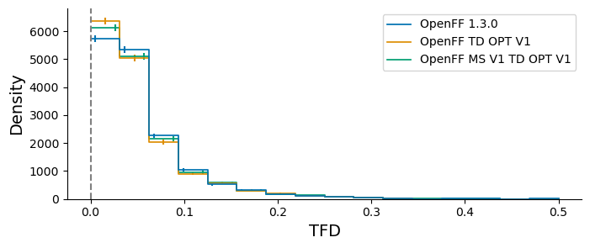
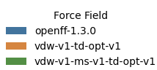
Modified Seminario* - heavily automated fitting pipeline used to explore new fitting target in days
b26=[#6:1]#[#7:2]
b27=[#6X2:1]#[#6X2:2]
b30=[#6X2:1]=[#7:2]
Josh Horton
Hypothesis
Force Constants Computed
Remaining Parameters Refit
New Parameters Benchmarked
Using the modified seminario method to derive bond and angle force constants directly from QC data yields more ‘physical’ values
The Cole group retrieved all hessian data generated by OpenFF and from this computed average bond and angle force constants
Within ~1 day OpenFF refit the rest of the valence parameters while restraining the force constants
Within a further ~1 day the new force field had been benchmarked against the QC data
* Alice E. A. Allen, Michael C. Payne, and Daniel J. Cole 10.1021/acs.jctc.7b00785

Slide 25

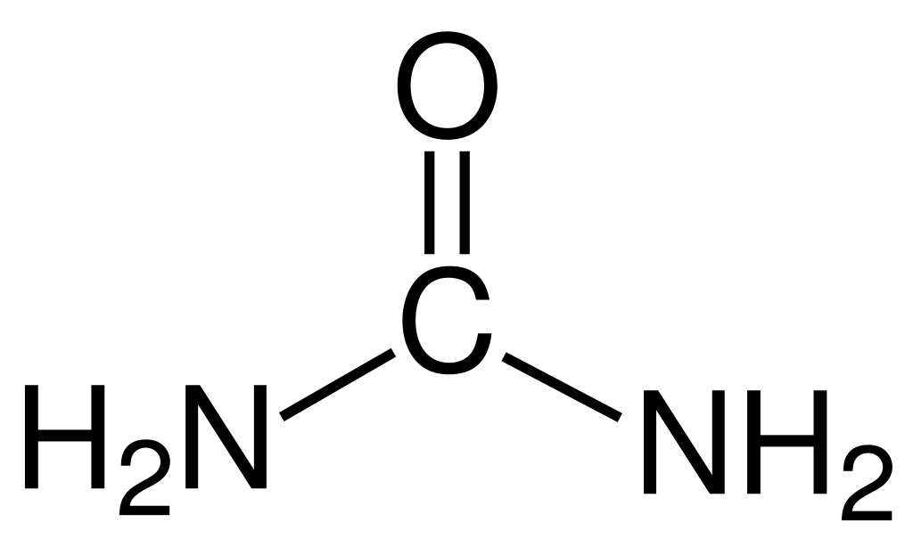

Refit Charge Models - AM1BCC charge model currently being re-trained against QC and exp. data
33
Double-bonded oxygen in a lactone or lactam
ESP / EF
+
+
O
O
RESP2 δ=0.6
O
N
[#8X1$(*=[#6r]@[#7r,#8r]):1]
Mixture enthalpies + densities
AM1BCC Ported to SMIRNOFF
Integrate Into Fitting Infrastructure
Training
Testing
A majority of the original AM1BCC parameters have been ported to SMIRNOFF
ForceBalance and the OpenFF Evaluator extended to support co-optimising against QC and exp. data
Test fits being performed against a combination of QC ESP / EF data and mixture exp. data
XtalPi benchmarking test fits against experimental solvation / transfer free energy data

Slide 26
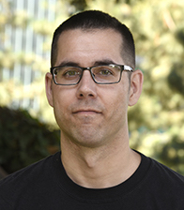
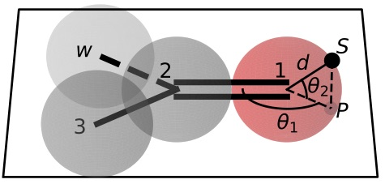

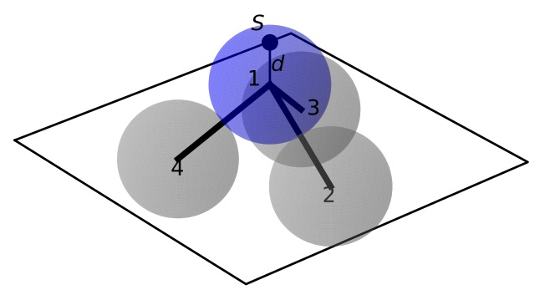
Virtual Sites - fitting infrastructure becoming available in weeks, followed by new science in months
+
ESP / EF
+
RESP2 δ=0.6
Trevor Gokey
Hypothesis
Software
Training
Testing
Interoperability
The inclusion of off-site charges should improve the accuracy of a force fields electrostatic interactions
Virtual site support added to the OpenFF toolkit. Support for training to QC ESP + EF data in progress
Virtual sites will be trained against ESP / EF QC data, based on input from the Cole group
Trained parameters will be benchmarked against experimental and physical property data
In order to include into mainline force field need major simulation packages to support proposed v-sites

Slide 27
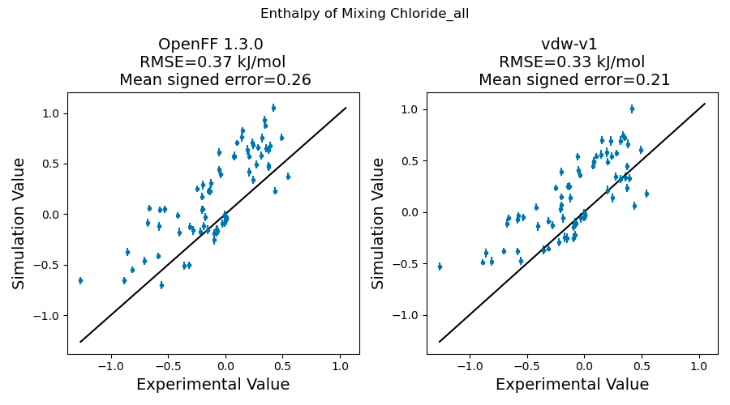
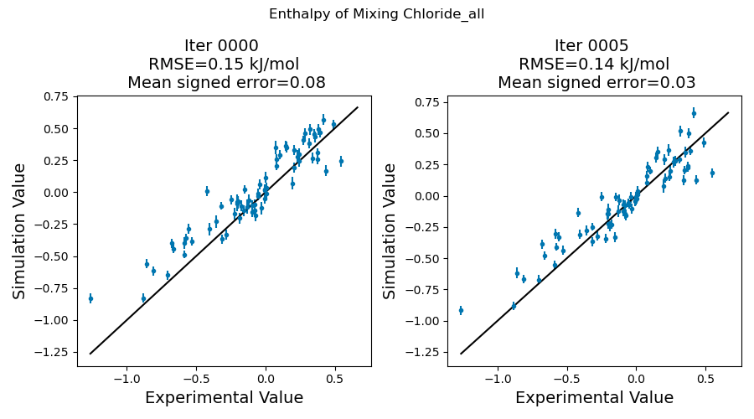
Virtual sites
Proof of concept: halogens and pyridines
ΔH_{mix}(𝑥) of mixtures containing Chlorine
OpenFF 1.3.0
OpenFF 2.0.0
FF + new BCCs / v-sites

Slide 28
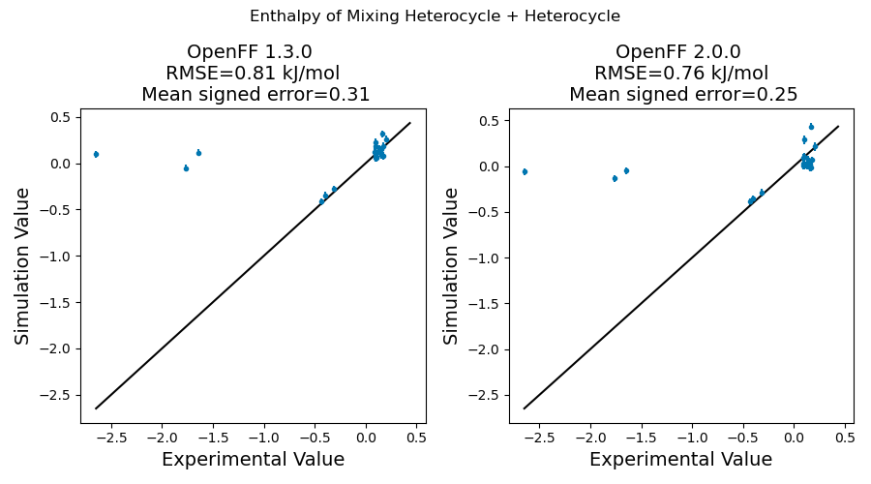
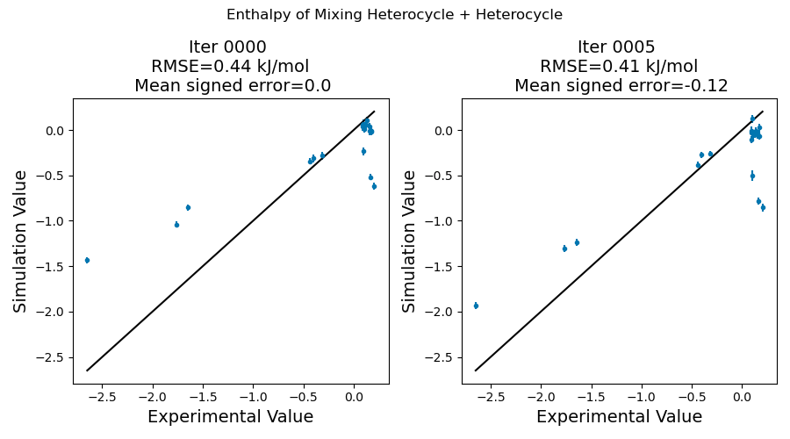
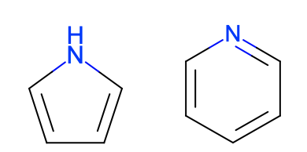
Virtual sites
Proof of concept: halogens and pyridines
ΔH_{mix}(𝑥) of Heteroaromatics
OpenFF 1.3.0
OpenFF 2.0.0
FF + new BCCs / v-sites

Slide 29
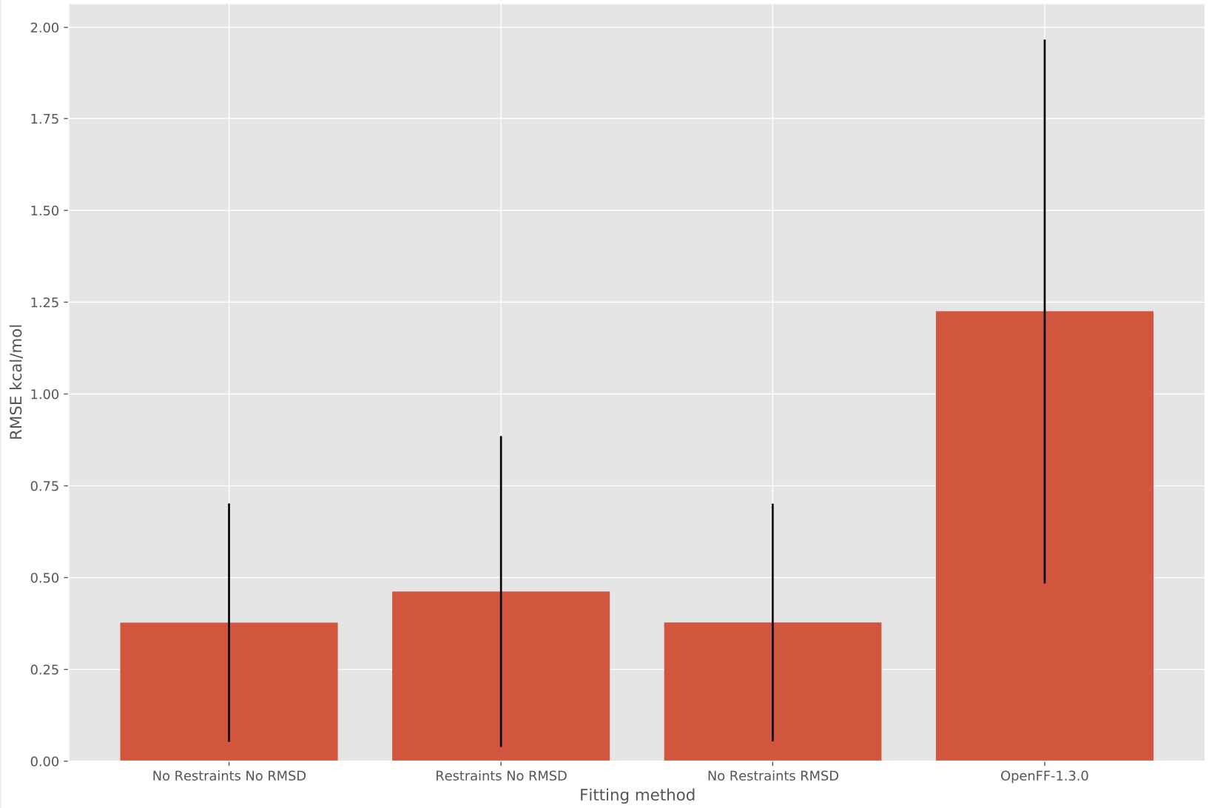
Bespoke Fitting - expect initial release of the bespoke fitting package in the next 1-2 months
TORSION PROFILE BEFORE AND AFTER FITTING THE JACS LIGAND FRAGMENTS
Can retrain torsion parameters to bespoke torsion scans generated for ‘fragments’ of original molecule
Working to expand to other valence terms
force constants from modified seminario method
Investigating the use of ANI2x models to rapidly generate torsion scan training data
2.00
1.50
Josh Horton
RMSE kcal / mol
1.00
0.50
0.00
OpenFF 1.3.0
Bespoke
* error bars show 1 std deviation

Slide 30
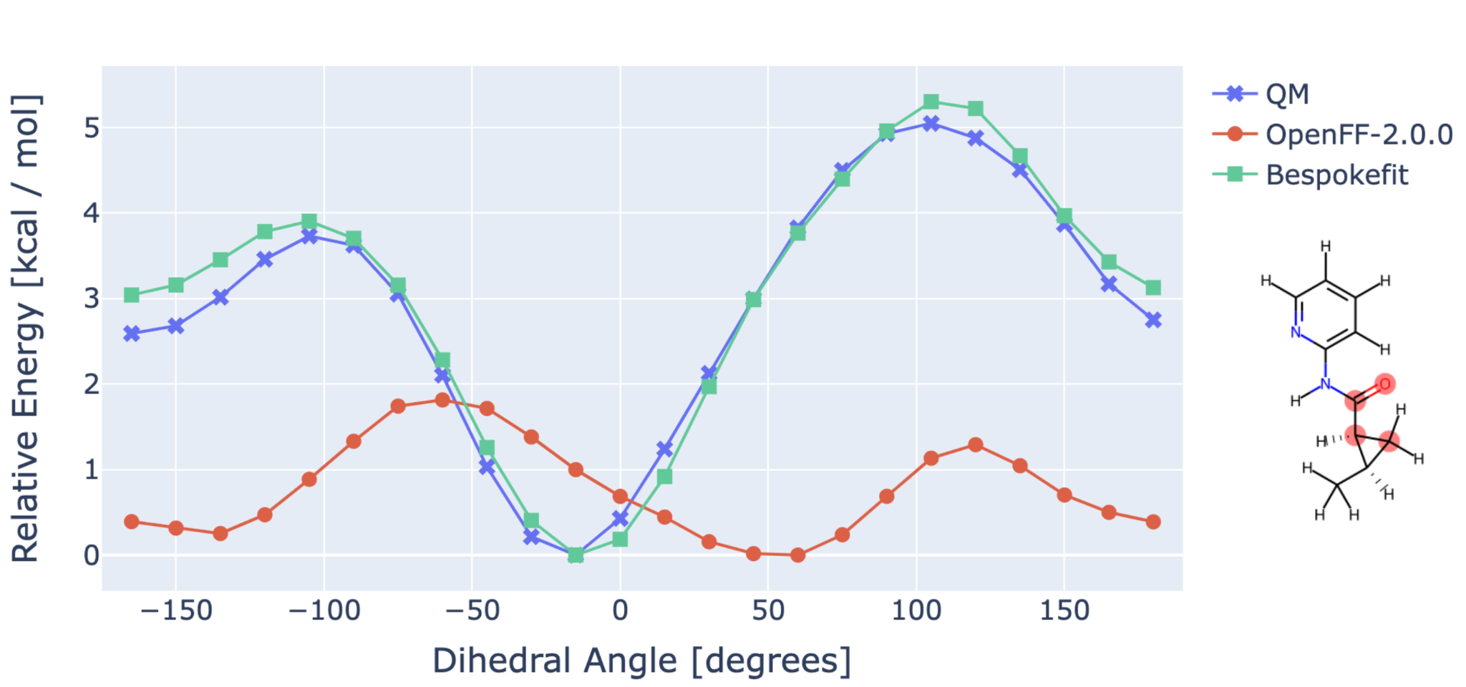


As well as our BespokeFit release for custom, more accurate torsional parameters
Can retrain torsion parameters to bespoke torsion scans generated for ‘fragments’ of original molecule
Very fast with GFN-XTB or similar; also works with QM method of choice

Slide 31
OPEN Software, OPEN Data, OPEN Science is rapidly facilitating force field science!
OPEN SOFTWARE
OPEN DATA
OPEN SCIENCE
Automated infrastructure enables rapid experimentation with minimum human intervention
Access to large, high quality experimental and quantum chemical data facilities easy curation of balanced train / test sets
Exploring new force field science:
hypothesis - build software - train - test - iterate
is now almost routine

Slide 32


Conclusions
aq. ΔG_{solv}
Sage looks even better than we expected!
Automated benchmarking has been a major focus and will point the way forward
We see community uptake, with and without our help
Bespoke torsion fitting will be ready soon and yields accuracy gains
New technology yields better starting points and better FFs

Slide 33
Acknowledgements
https://openforcefield.org/about/organization/
Too many other folks over the years to list, including the AMBER FF community, the GAFF/GAFF2 developers, etc.
NIH and NSF for funding work that helped pave the way to this effort
Consortium and NIH for current funding, plus MolSSI and others for fellowship funding
OpenEye for support + Chris Bayly’s sabbatical which helped launch this

